Slide 1
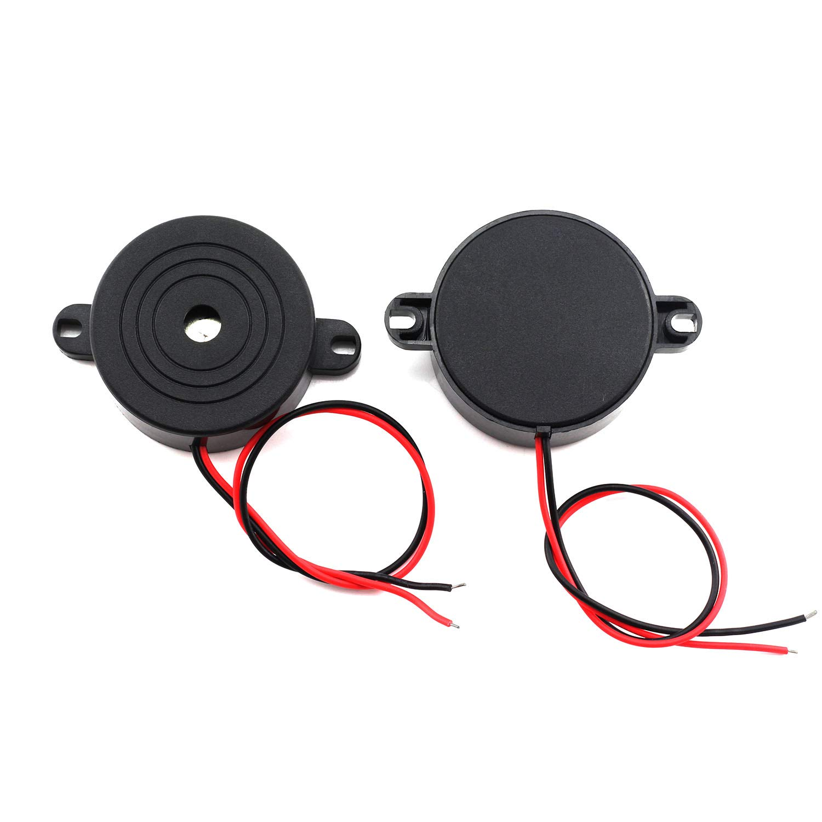
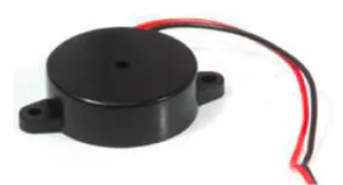
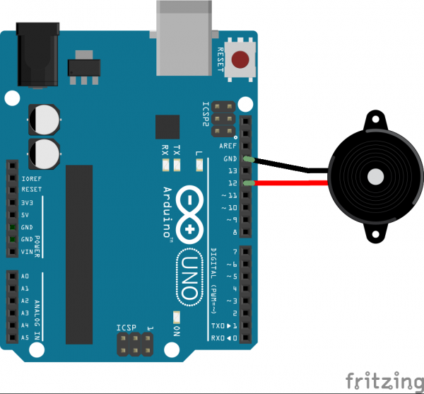
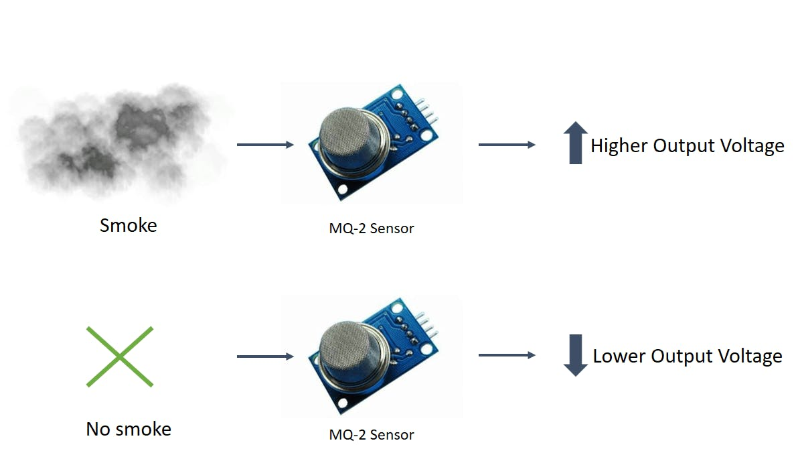
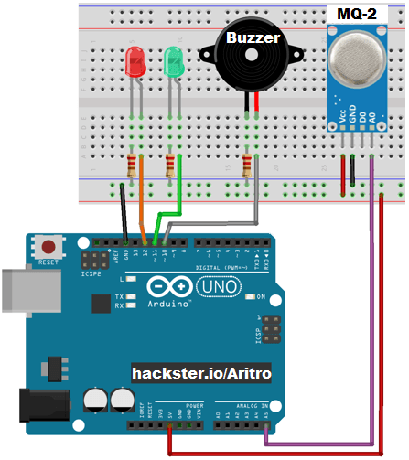
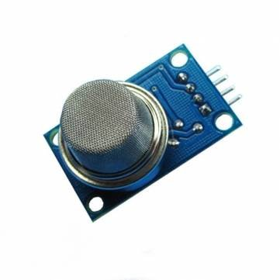
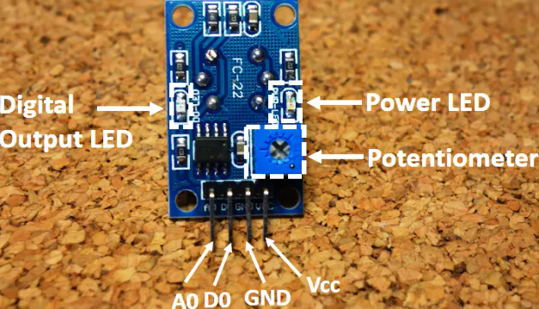
Piezo buzzers are simple devices that are commonly used to produce beeps and sounds in many electronic gadgets, like alarm clocks, toys, pc boards, etc. They consume very little current and have high impedance, which means that you can safely connect them directly to a micro-controller pin.
The MQ-2 smoke sensor is sensitive to smoke and to the following flammable gases:
LPG, Butane, Propane, Methane, Alcohol, Hydrogen
The resistance of the sensor is different depending on the type of the gas.
The smoke sensor has a built-in potentiometer that allows you to adjust the sensor sensitivity according to how accurate you want to detect gas.
The voltage that the sensor outputs changes accordingly to the smoke/gas level that exists in the atmosphere. The sensor outputs a voltage that is proportional to the concentration of smoke/gas.
In other words, the relationship between voltage and gas concentration is the following:
The greater the gas concentration, the greater the output voltage
The lower the gas concentration, the lower the output voltage

Slide 2
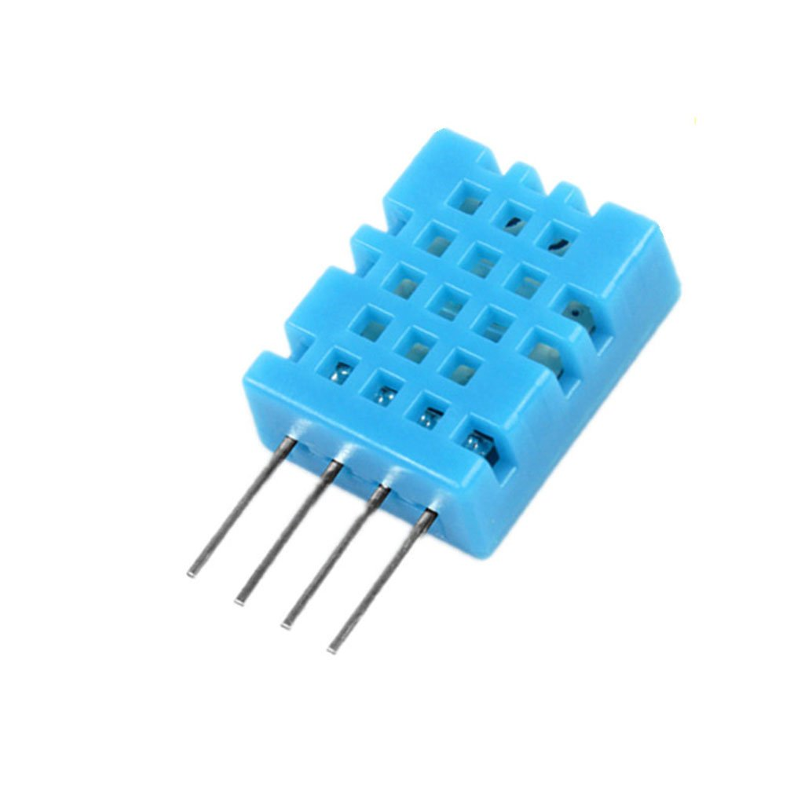
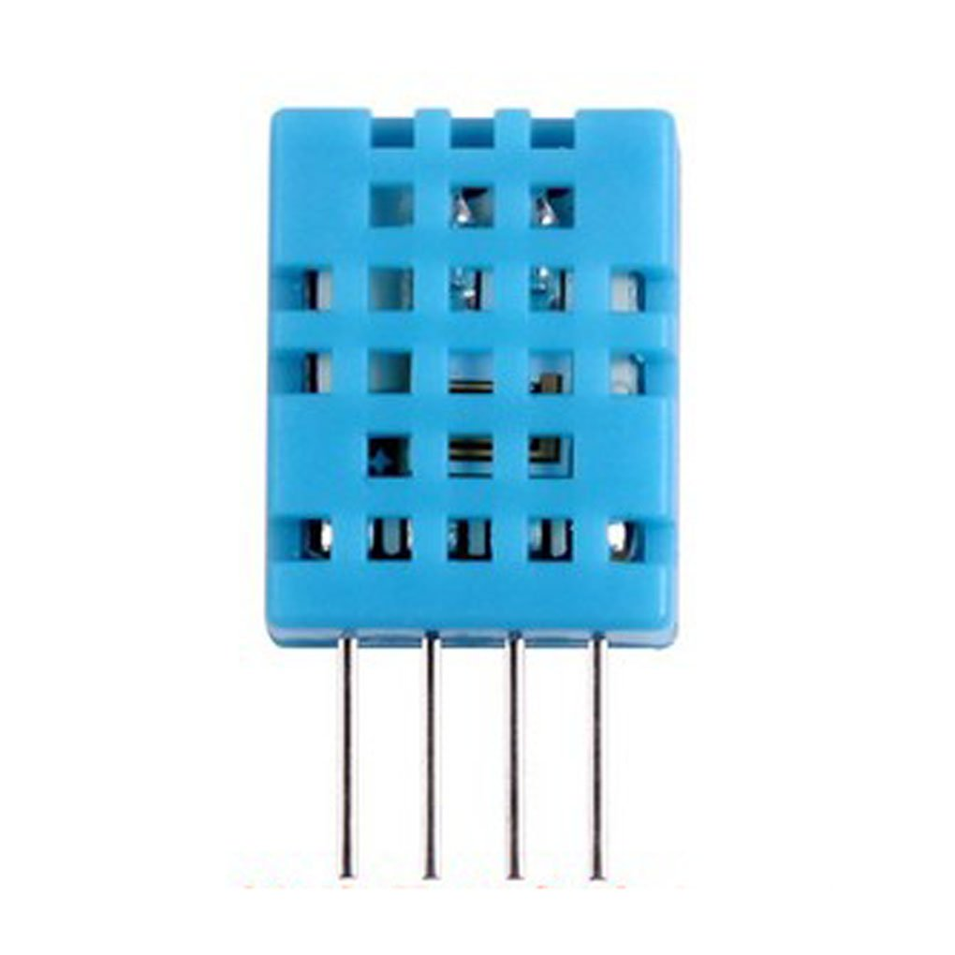
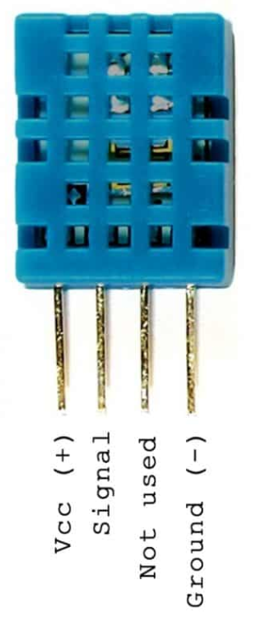
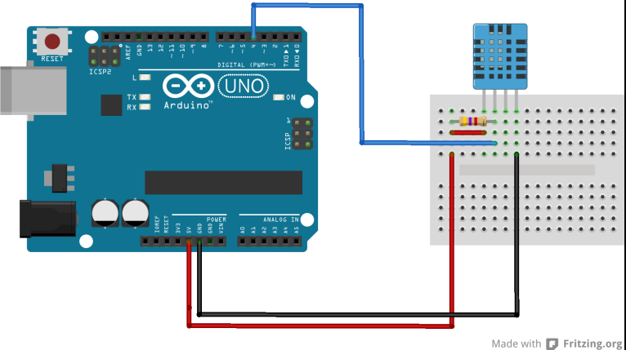
Humidity Range: 20-90% RH
Temperature Range: 0-50 °C
The DHT11 is a basic, ultra low-cost digital temperature and humidity sensor. It uses a capacitive humidity sensor to measure humidity and a thermistor to measure the temperature of surrounding air
Humidity is the water vapor around you mixed with air. It is measured in per cents. So, if the humidity is 60 per cent(which is the average humidity), then 60 per cent of the air around you is water vapor

Slide 3
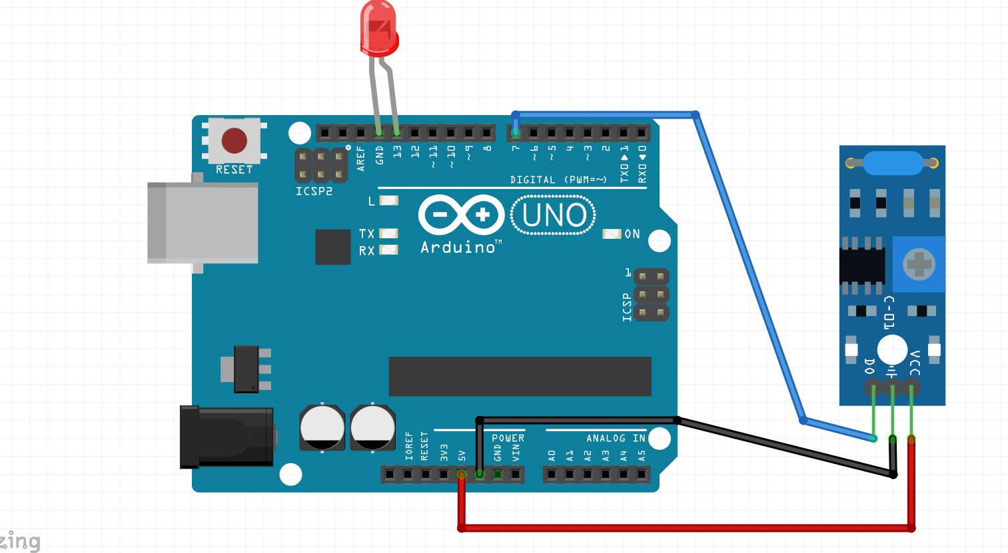
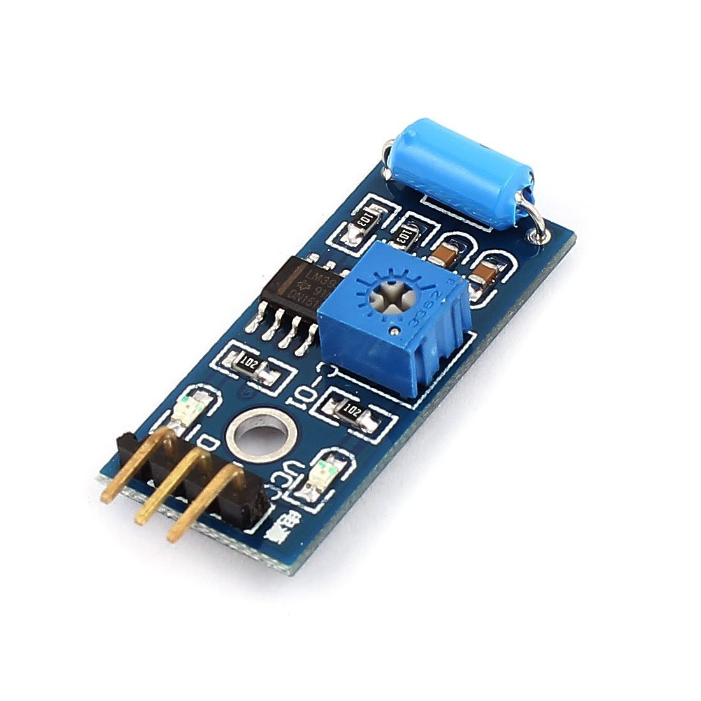
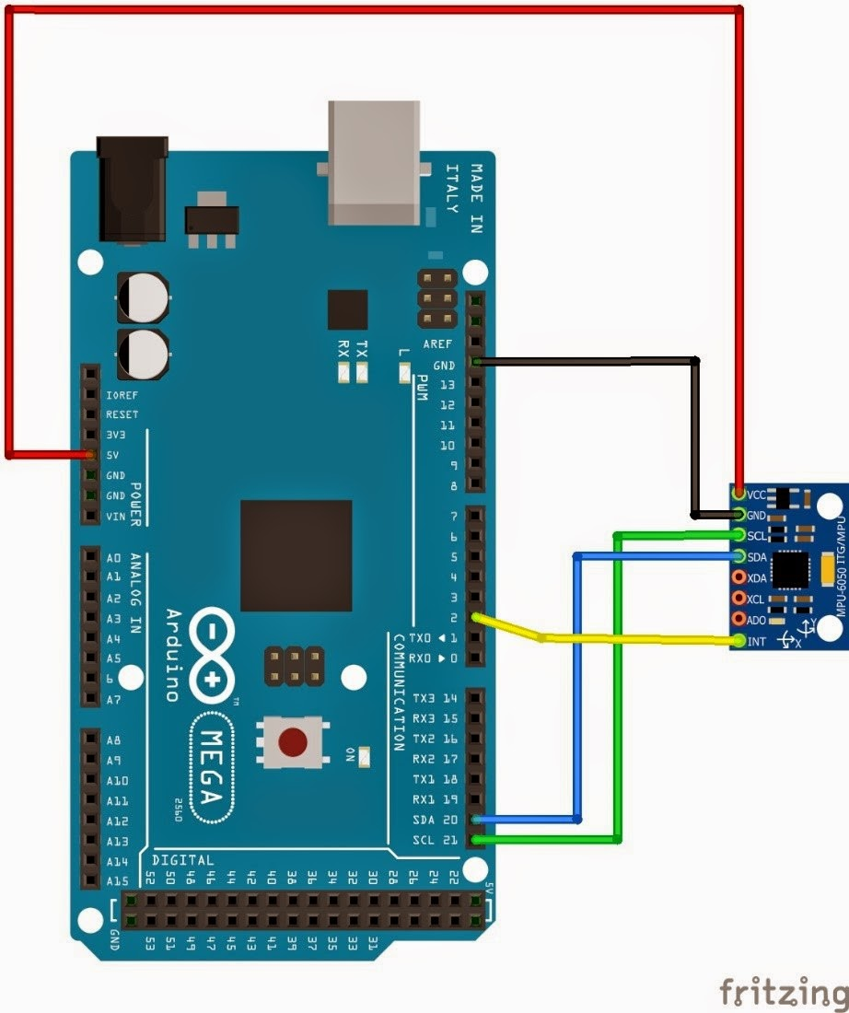
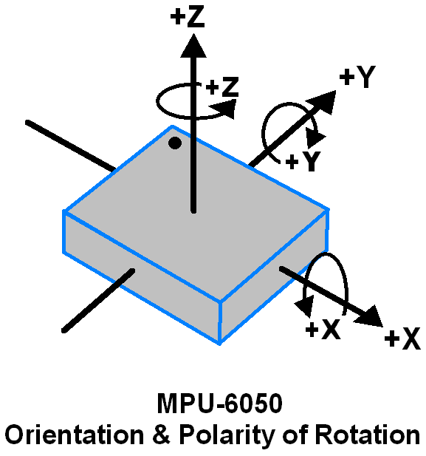
The Vibration module based on the vibration sensor SW-420 and Comparator LM393 to detect if there is any vibration that beyond the threshold. The threshold can be adjusted by the on-board potentiometer.
When this no vibration, this module output logic LOW the signal indicate LED light,And vice versa.
The MPU6050 IMU has both 3-Axis accelerometer and 3-Axis gyroscope integrated on a single chip.
The gyroscope measures rotational velocity or rate of change of the angular position over time, along the X, Y and Z axis.
MPU6050 accelerometer measures acceleration in the same way as explained in the previous video for the ADXL345 accelerometer sensor. Briefly, it can measure gravitational acceleration along the 3 axes and using some trigonometry math we can calculate the angle at which the sensor is positioned.

Slide 4
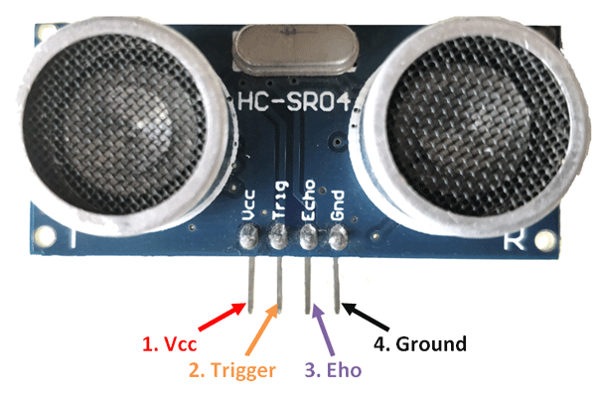
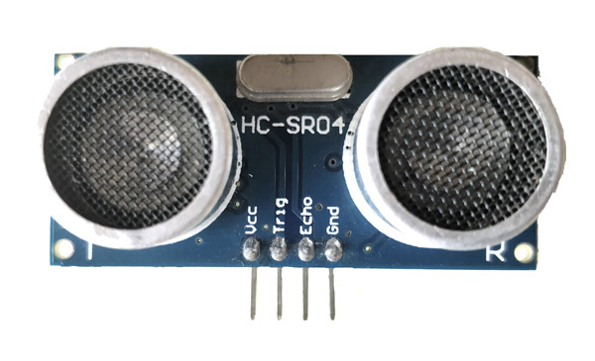
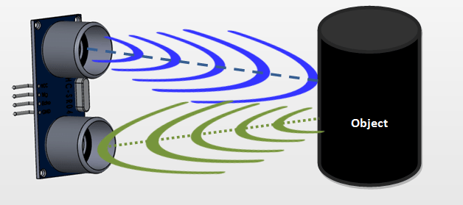
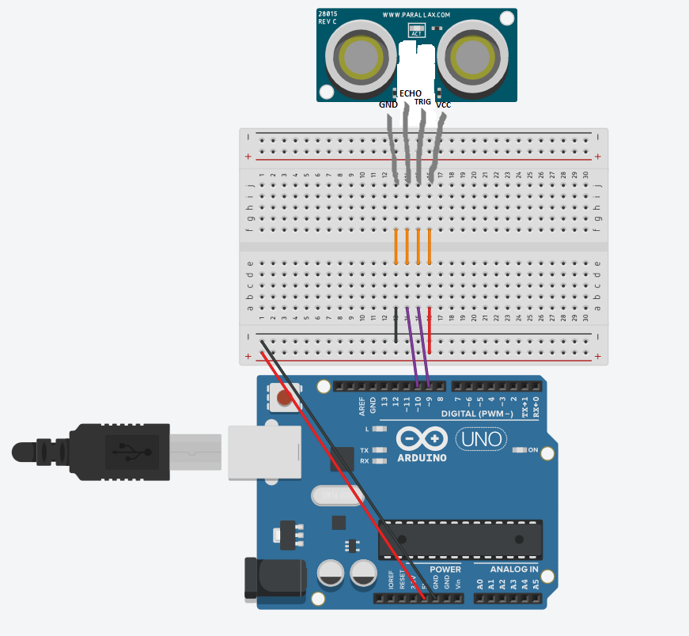
HC-SR04 Ultrasonic sensor
Distance = Speed × Time
Ranging Distance: 2cm - 4m
It works by sending sound waves from the transmitter, which then bounce off of an object and then return to the receiver. You can determine how far away something is by the time it takes for the sound waves to get back to the sensor
The Ultrasonic transmitter transmits an ultrasonic wave, this wave travels in air and when it gets objected by any material it gets reflected back toward the sensor this reflected wave is observed by the Ultrasonic receiver module as shown in the picture below
Ultrasonic Sensor Working
Now, to calculate the distance using the above formulae, we should know the Speed and time. Since we are using the Ultrasonic wave we know the universal speed of US wave at room conditions which is 330m/s. The circuitry inbuilt on the module will calculate the time taken for the US wave to come back and turns on the echo pin high for that same particular amount of time, this way we can also know the time taken. Now simply calculate the distance using a microcontroller or microprocessor.

Slide 5
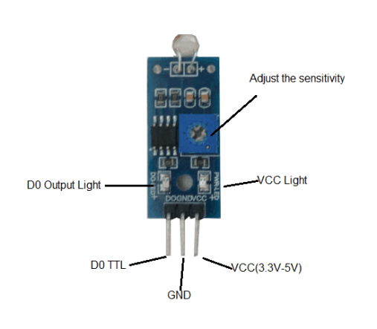
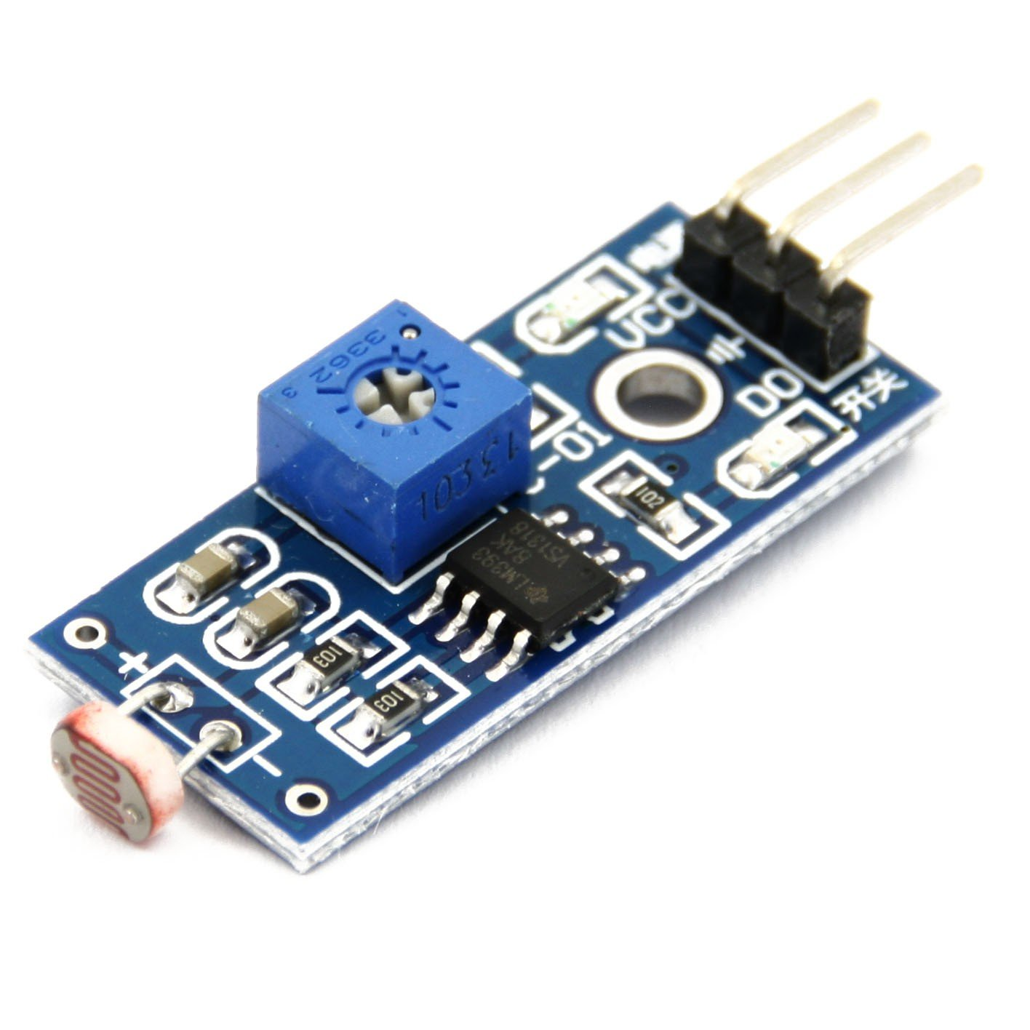
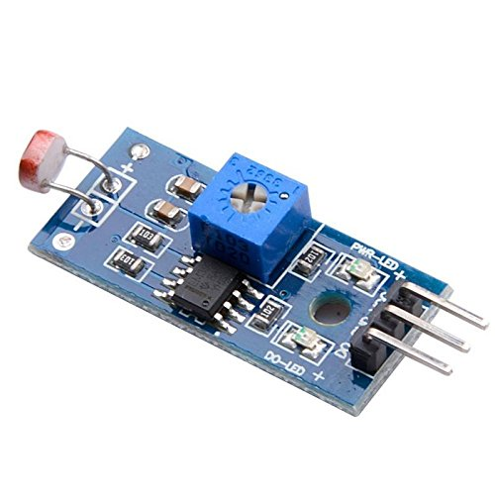
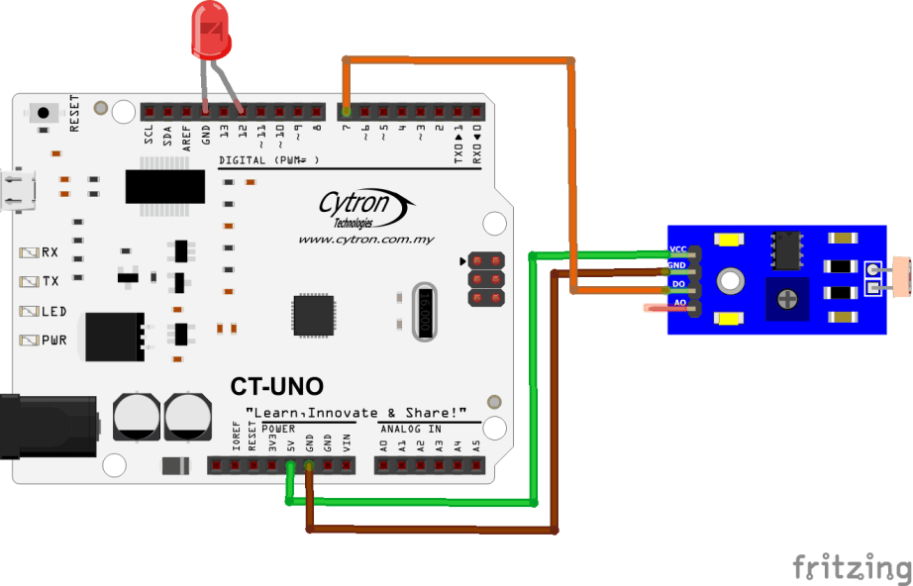
SN-LIGHT-MOD is a photosensitive resistor module, suitable to detect environmental light intensity and ambient brightness. Its sensitivity can be tuned with an on board potentiometer, where turning it clockwise will increase the sensitivity and increase the detection range.
Use it to detect the light brightness in your environment and decide to switch OFF or ON light? Or maybe to adjust the brightness of LED for your house? It comes with digital and analog output. You can adjust the threshold (sensitivity) of digital output by tuning the on board varible resistor (potentiometer). Simple usage as it is digital output, so you will know is the light is preseted and decide what to do with it.

Slide 6
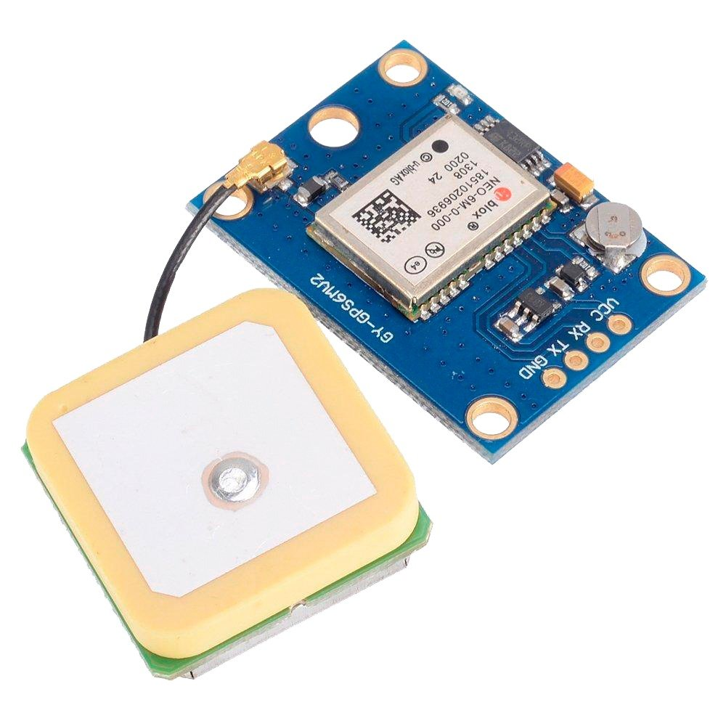
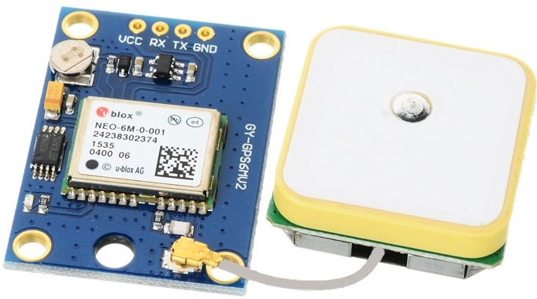
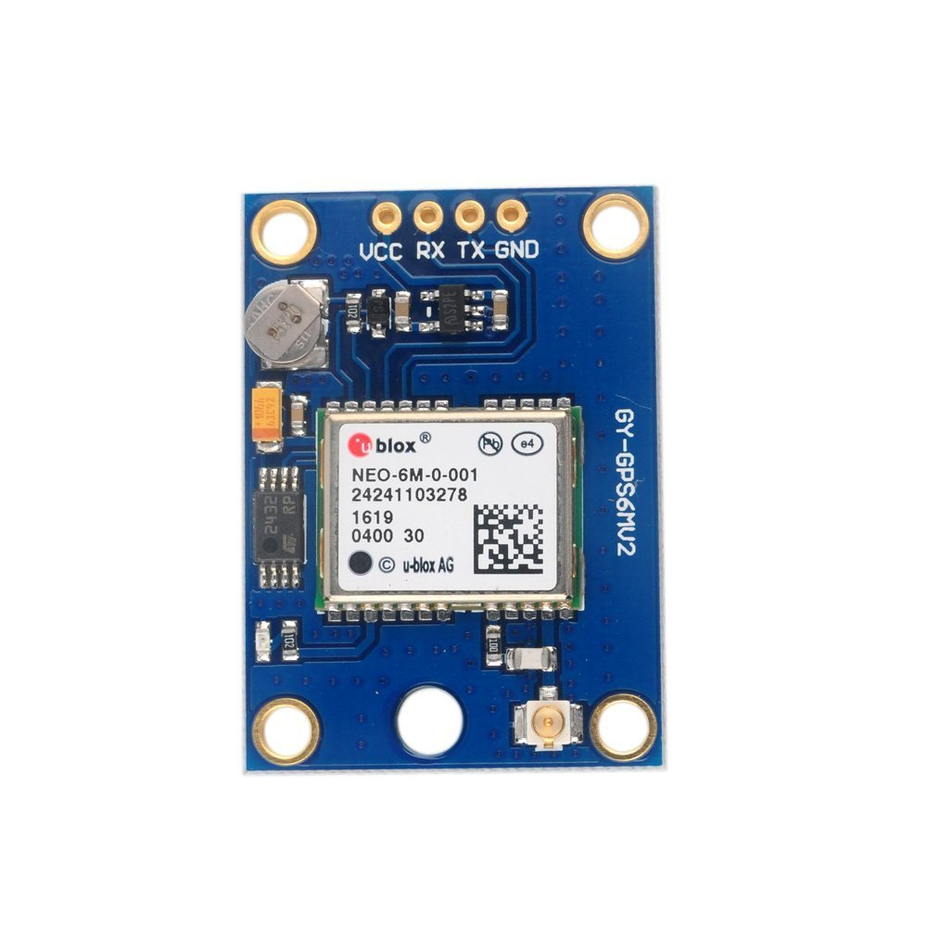
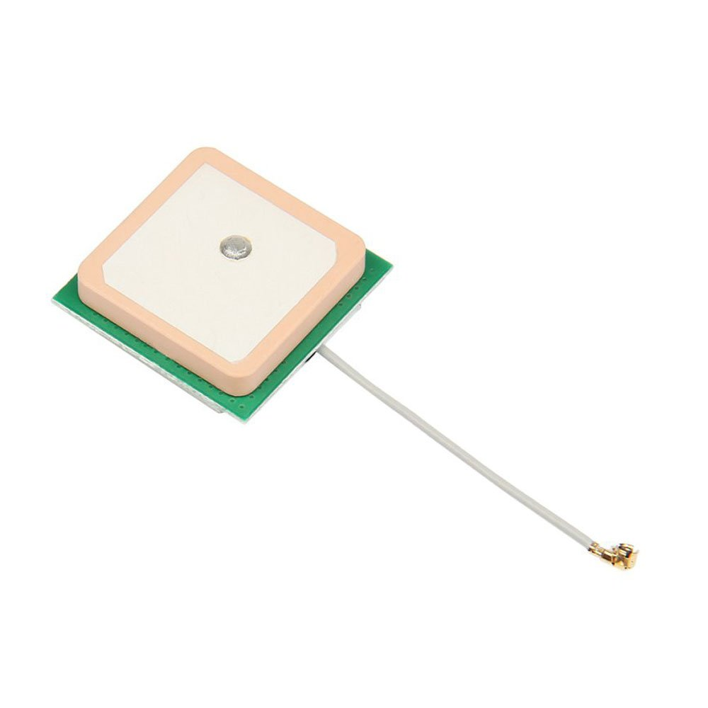
GPS satellites transmit at least 2 low-power radio signals. The signals travel by line of sight, meaning they will pass through clouds, glass and plastic but will not go through most solid objects, such as buildings and mountains. However, modern receivers are more sensitive and can usually track through houses.
These GPS satellites transmit information signal over radio frequency (1.1 to 1.5 GHz) to the receiver. With the help of this received information, a ground station or GPS module can compute its position and time.
What is GPS
The Global Positioning System (GPS) is a satellite-based navigation system made up of at least 24 satellites. GPS works in any weather conditions, anywhere in the world, 24 hours a day, with no subscription fees or setup charges.
How GPS works
GPS satellites circle the Earth twice a day in a precise orbit. Each satellite transmits a unique signal and orbital parameters that allow GPS devices to decode and compute the precise location of the satellite. GPS receivers use this information and trilateration to calculate a user's exact location. Essentially, the GPS receiver measures the distance to each satellite by the amount of time it takes to receive a transmitted signal. With distance measurements from a few more satellites, the receiver can determine a user's position and display it.
To calculate your 2-D position (latitude and longitude) and track movement, a GPS receiver must be locked on to the signal of at least 3 satellites. With 4 or more satellites in view, the receiver can determine your 3-D position (latitude, longitude and altitude). Generally, a GPS receiver will track 8 or more satellites, but that depends on the time of day and where you are on the earth.

Slide 7
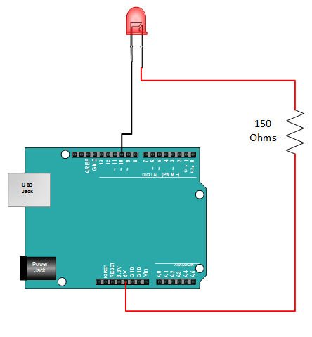
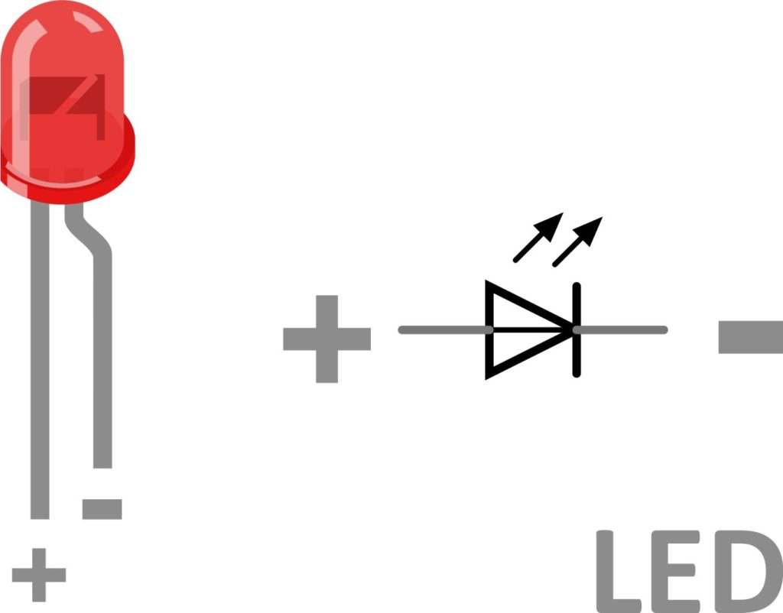
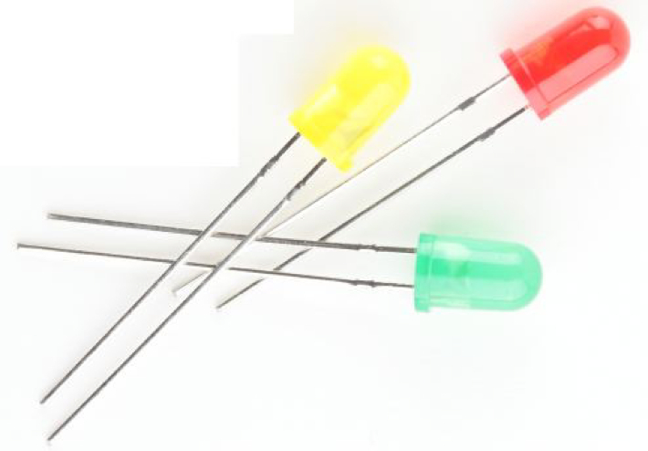
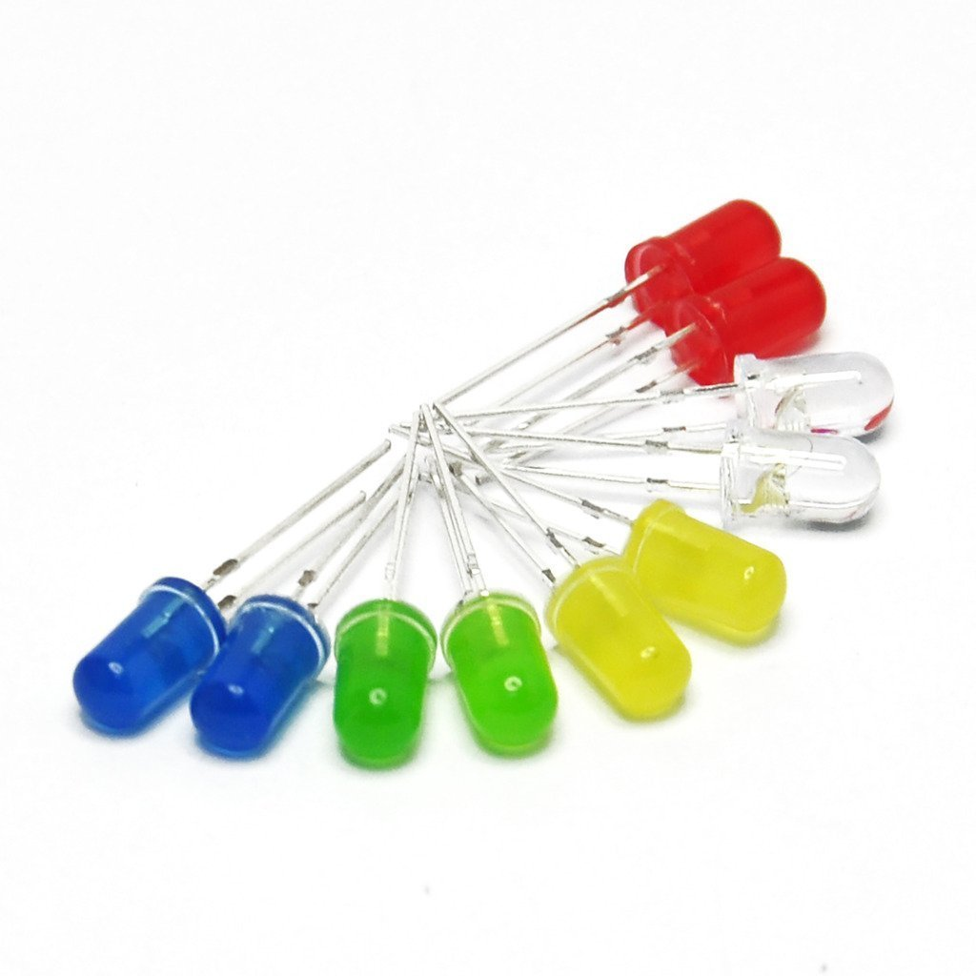
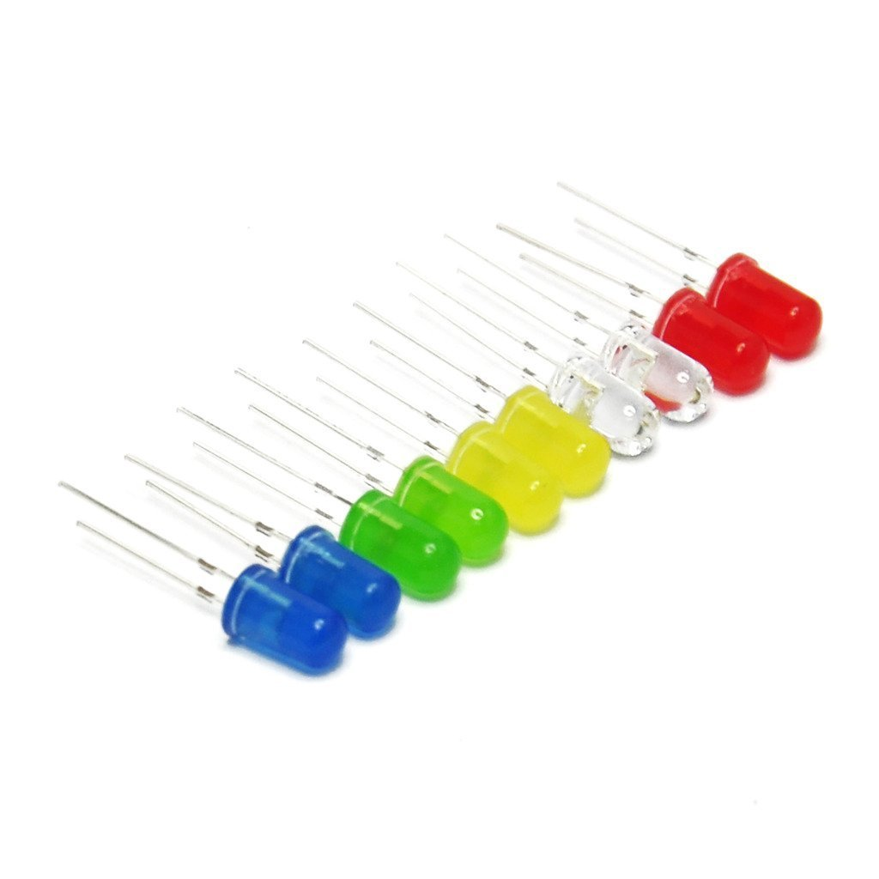

Slide 8
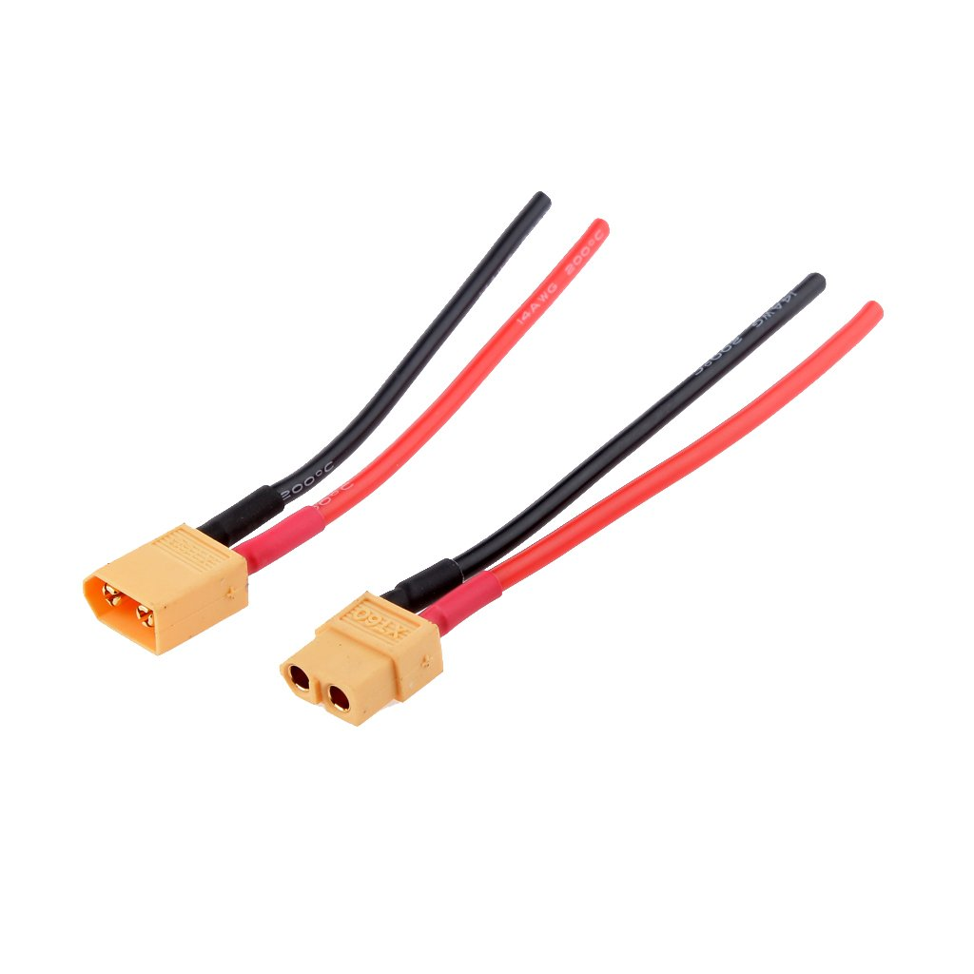
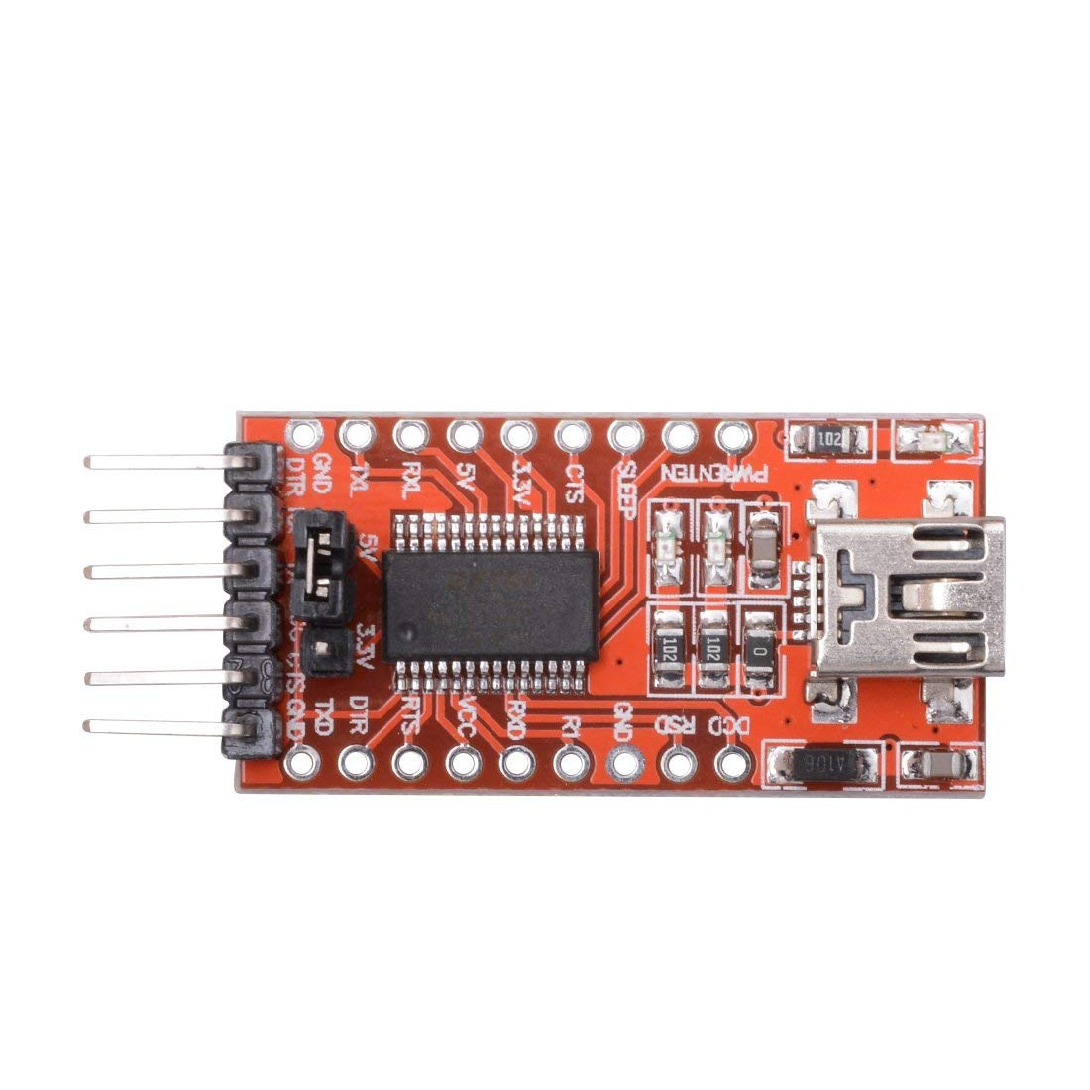
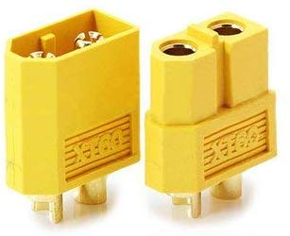

Slide 9
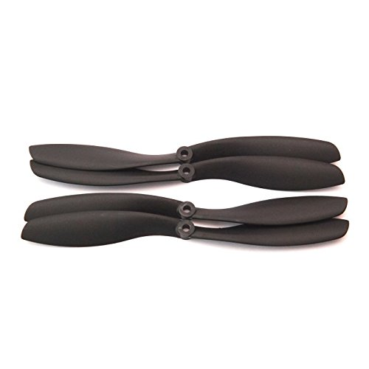
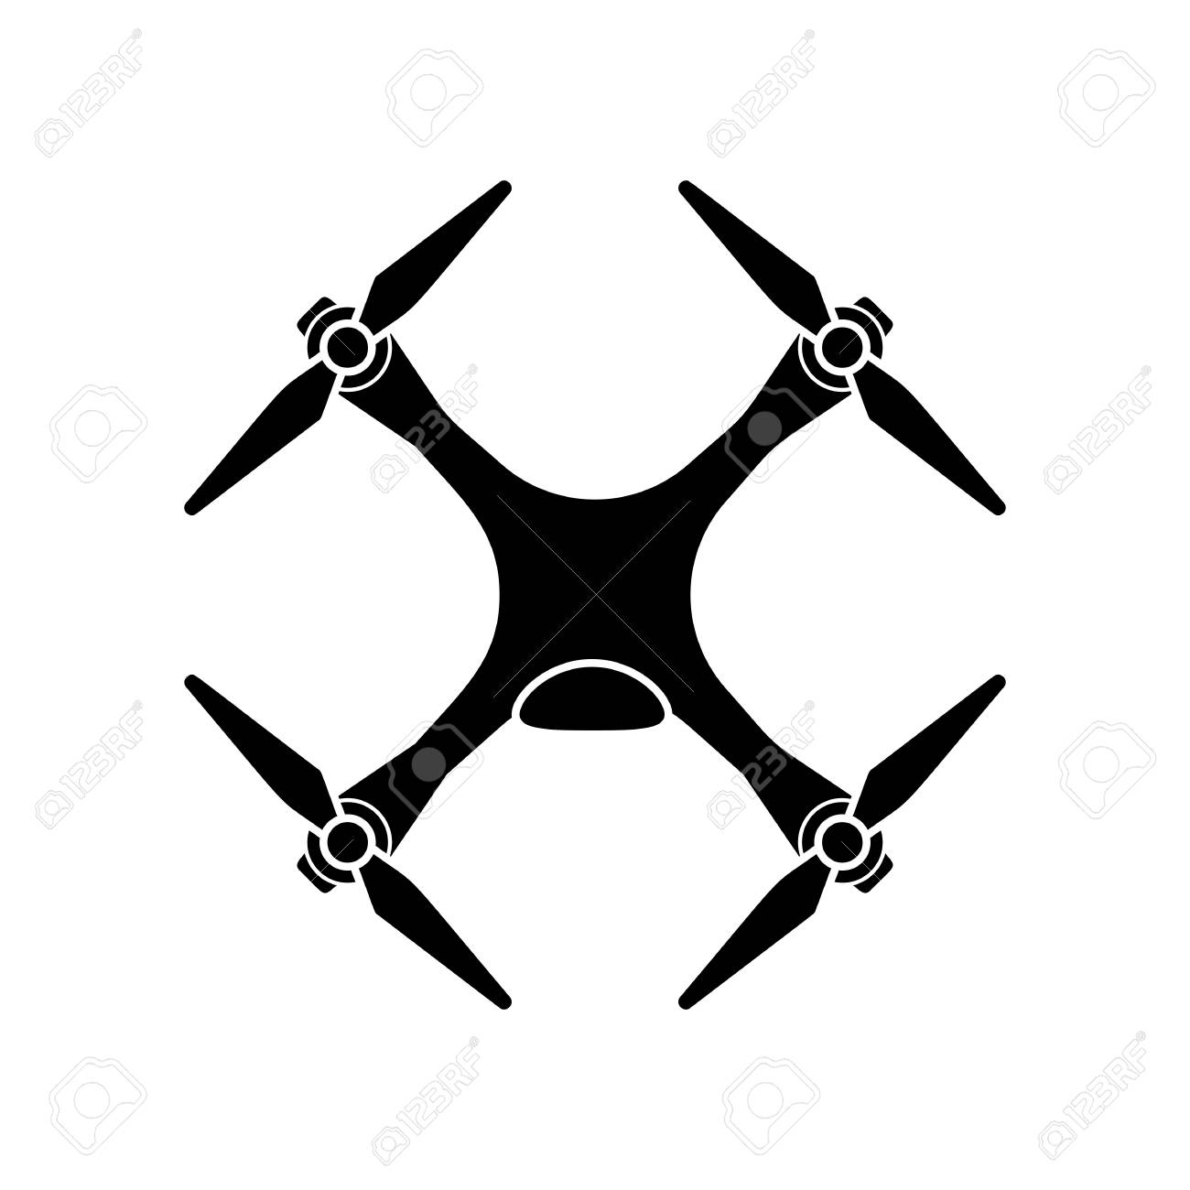
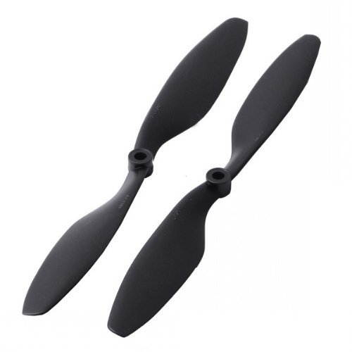
Material:carbon nylon
Size: 1 x 4.5"
Length: 10 inch (25.4cm)
Slope: 4.5 inch (11.43cm)
Weight: 30 gms

Slide 10
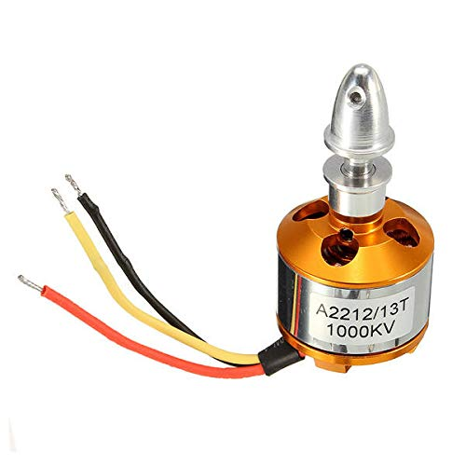
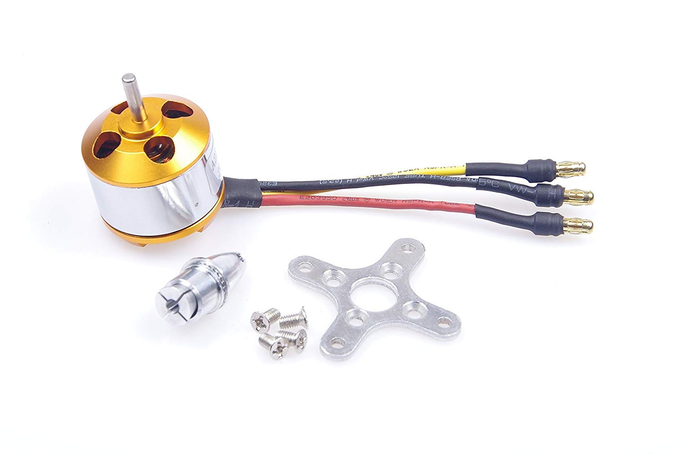
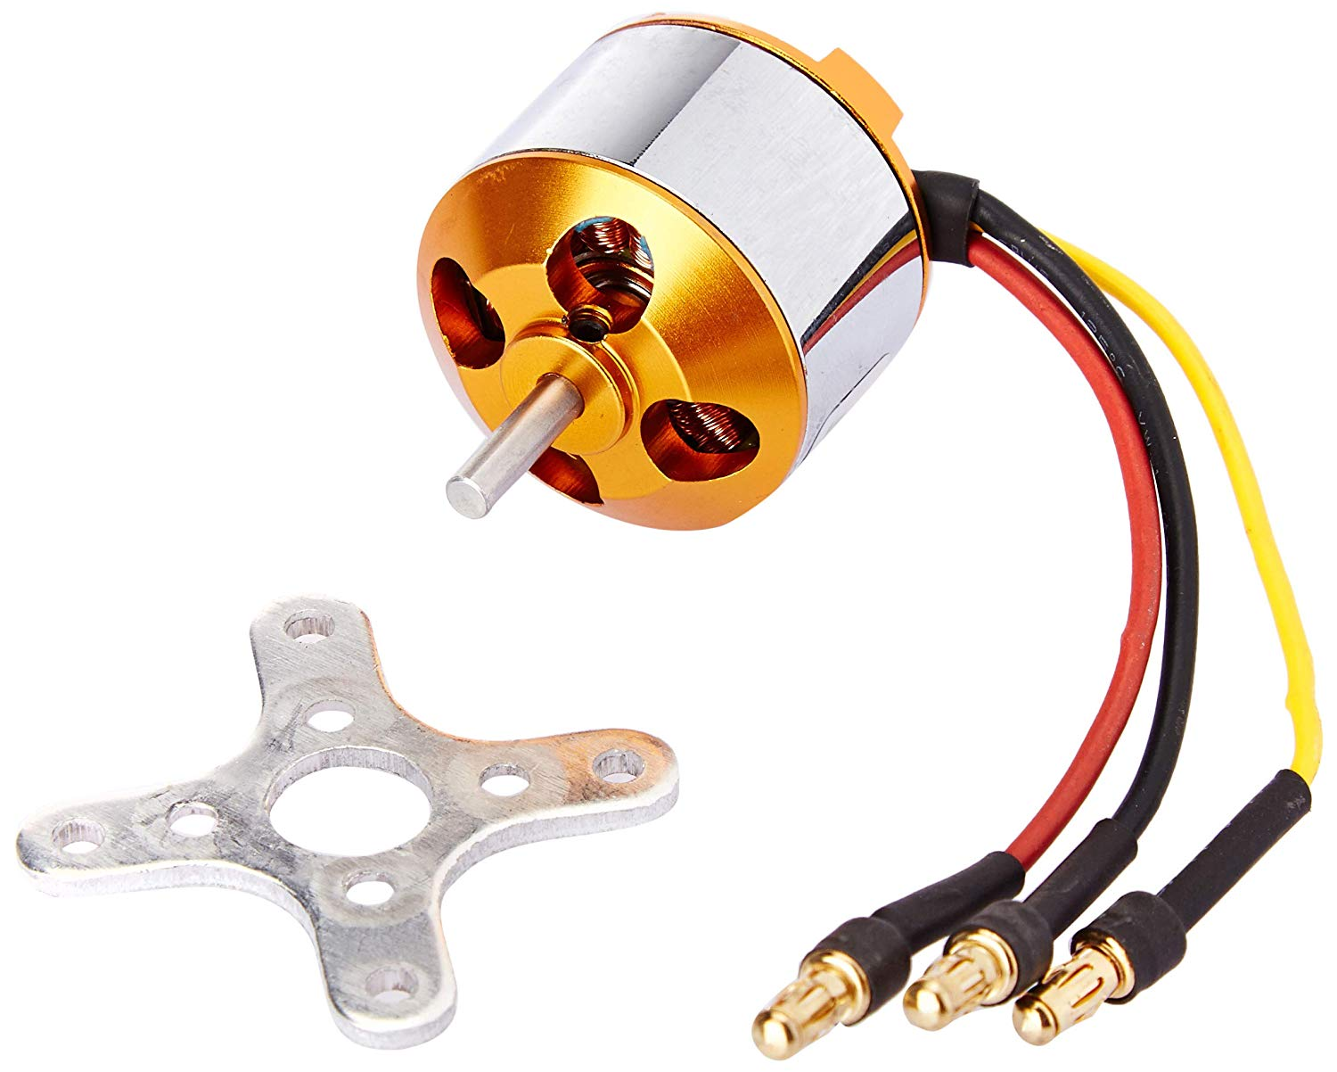
1000 kv brushless DC motor

Slide 11
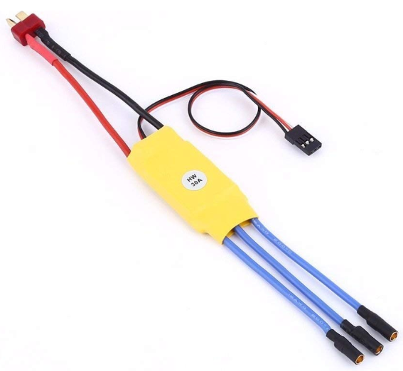
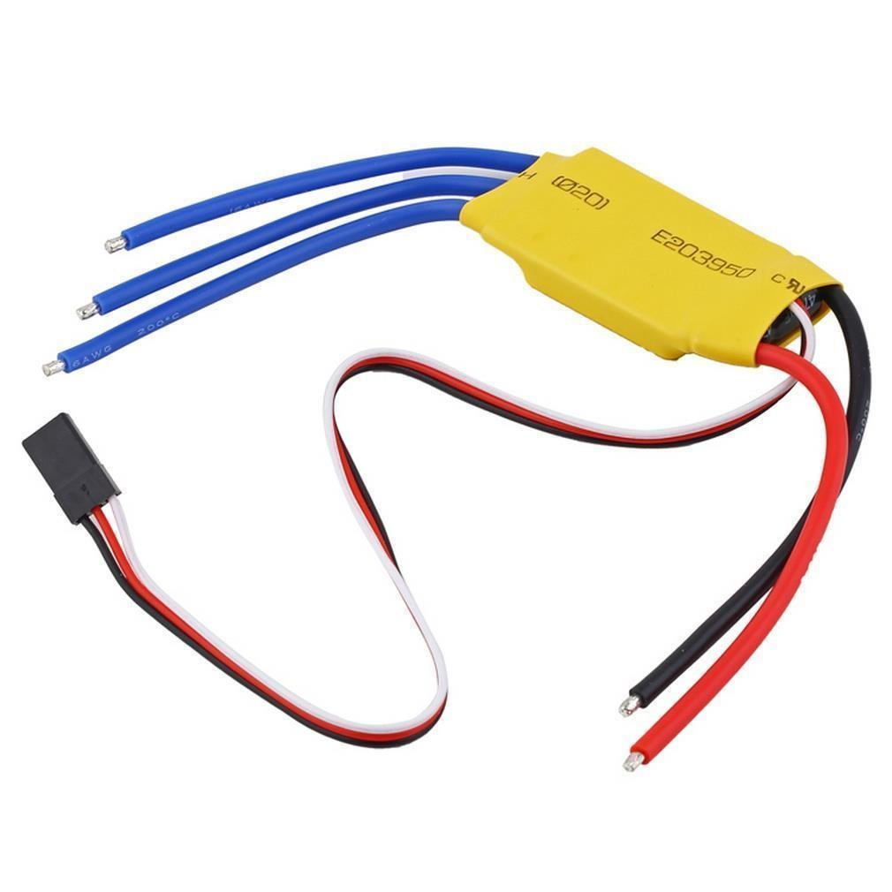

Slide 12
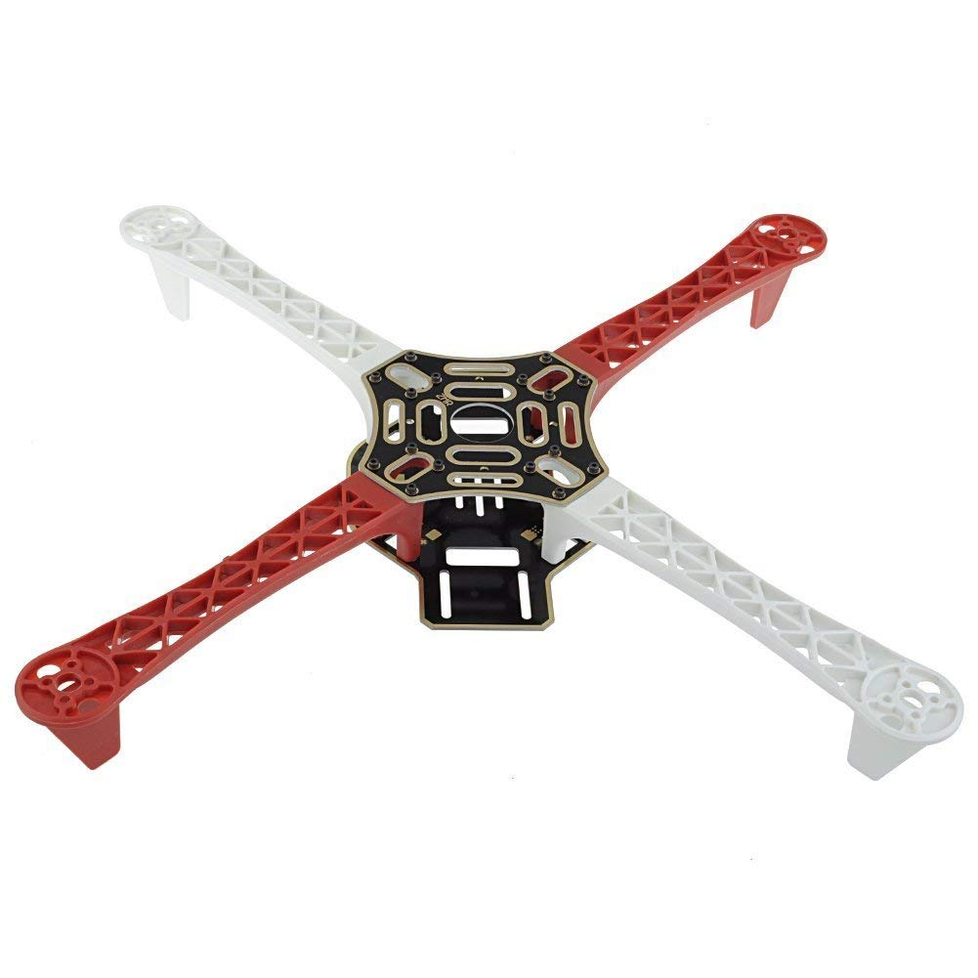
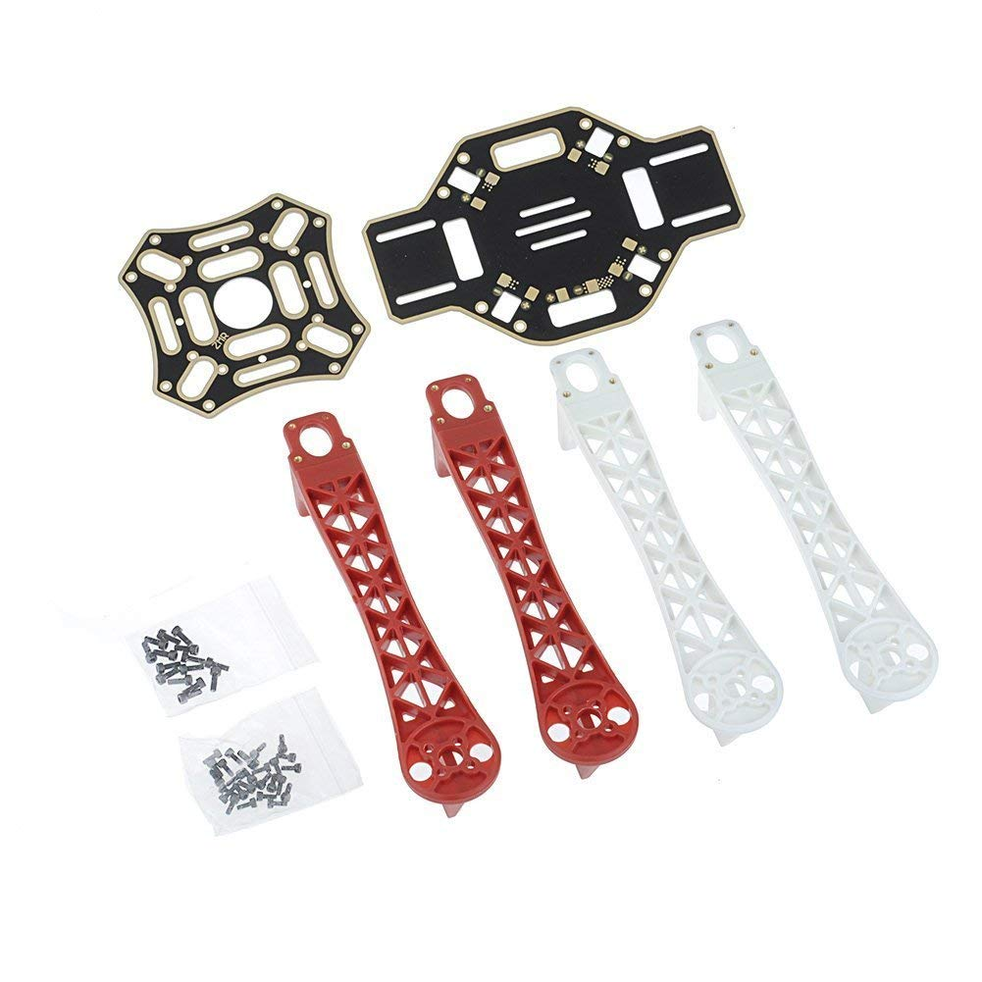
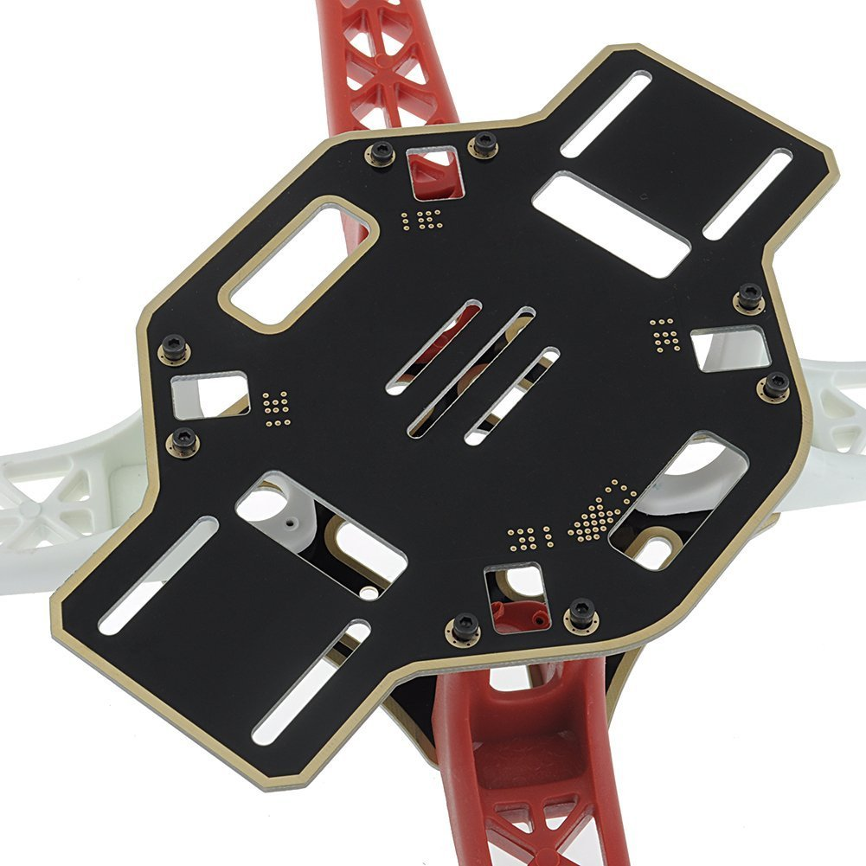
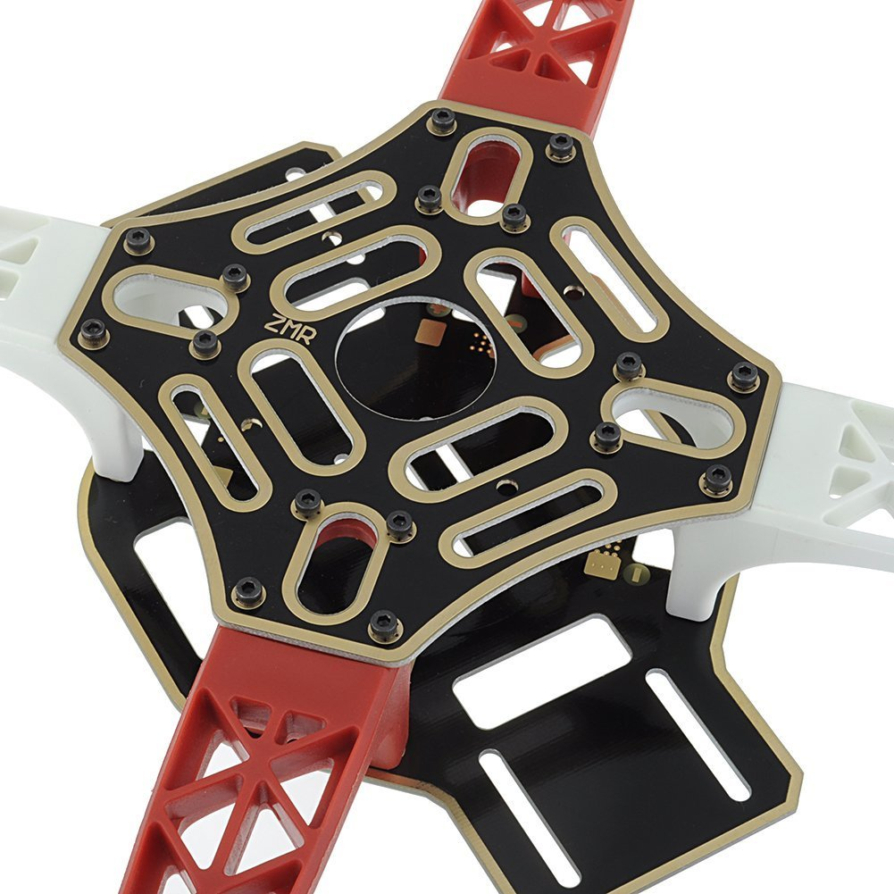
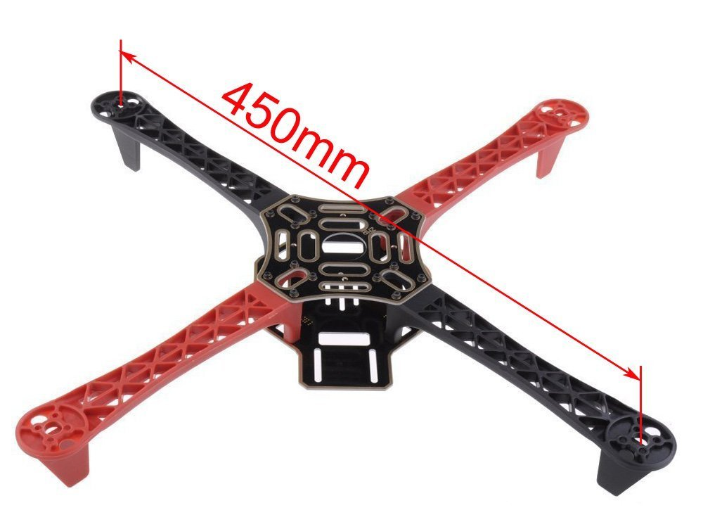
Built from quality glass fiber and polyamide nylon
• Pre-threaded brass sleeves for all of the frame bolts
• Colored arms for orientation to keep you flying in the right direction
• Large mounting tabs on main frame bottom plate for easy camera mounting
• Easy assembly

Slide 13
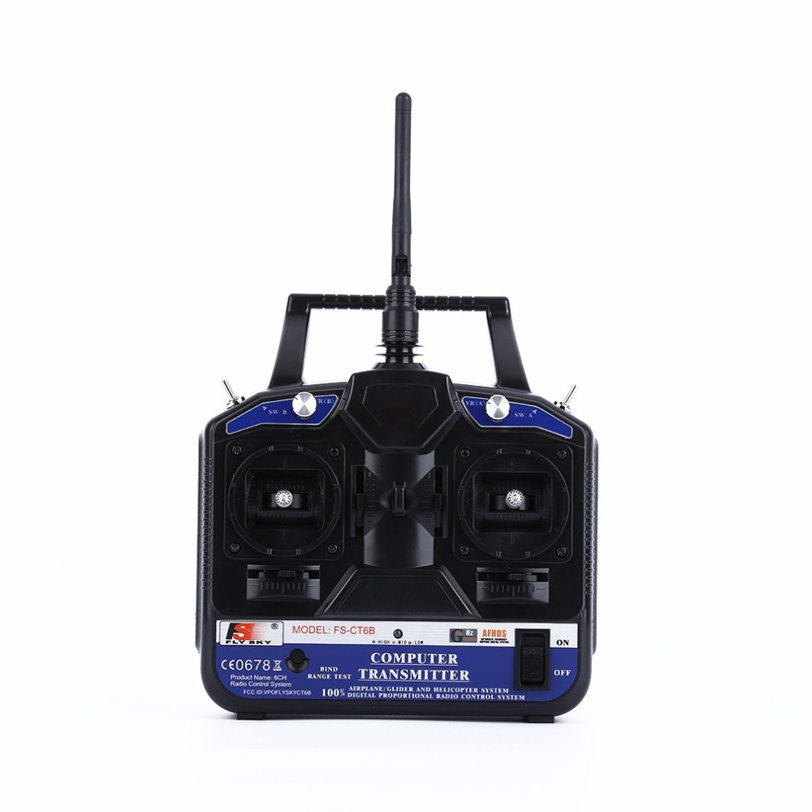
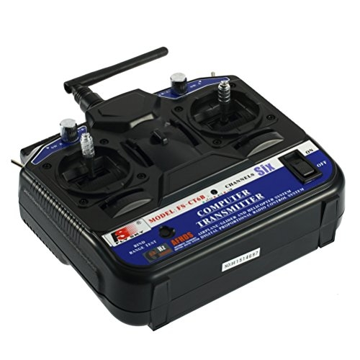




Robocraze Flysky CT6B Remote 6 Channel Transmitter and Receiver for Quadcoopter
Fs-ct6b transmitter and fs-r6b receiver
6 Channel radio
2.4GHz signal technology
Ideal for quad-copters and multi-copters that require 6CH operation

Slide 14



ESP32-CAM is an ESP-32 based mini WiFi camera module supporting OV2640 and OV7670 cameras with built-in Micro SD port and Flash featuring Facial Recognition, wireless image upload and real time video transmission over IP.
Note: Diagrams are generic and actual pictures (such as logo) may vary.

Slide 15



ESP8266 Wifi Module
ESP8266 is Wi-Fi enabled system on chip (SoC) module developed by Espressif system. It is mostly used for development of IoT (Internet of Things) embedded applications.
ESP8266 module is low cost standalone wireless transceiver that can be used for end-point IoT developments.
To communicate with the ESP8266 module, microcontroller needs to use set of AT commands. Microcontroller communicates with ESP8266-01 module using UART having specified Baud rate.

Slide 16





Slide 17






Slide 18


Rated voltage: 11.1v
Rated current: 2200mah 30c/25c
This is a simple and compact LiPoly balance charger for 2~3s batteries. It features built in JST-XH balance plug ports and 3 LEDs to indicate charge status.
Comes with Inbuilt Power Supply. So you can straightaway plug it into the wall outlet. It's an ideal charger to charge your LiPo Packs.
Simple, reliable and safe to use Built in power supply 100~240V Compatible Automatic charging start and stop

Slide 19




A resistor is a passive two-terminal electrical component that implements electrical resistance as a circuit element. In electronic circuits, resistors are used to reduce current flow, adjust signal levels, to divide voltages, bias active elements, and terminate transmission lines, among other uses.
1N4007 is a PN junction rectifier diode. These types of diodes allow only the flow of electrical current in one direction only
Often used for reverse voltage protection

Slide 20



Interface: 1 10/100Mbps WAN/LAN port, USB 2.0 port for 3G modem, a mini USB port for power supply
Button: quick setup security button, reset button, mode switch
External power supply: 5VDC/1.0A
Wireless standards: IEEE 802.11n, IEEE 802.11g, IEEE 802.11b
Portable design, light and small enough for you to take anywhere

Slide 21





Block diagram
Drone
Radio frequency
Wireless
Wireless
Transmitter
Receiver
Wireless Camera
(ESP32-CAM)
Wireless router
(Access Point)
KK 2.1.5
Flight Controller
Wireless
Arduino Mega
Wireless
ESC
Wireless module
(ESP8266)
No. of sensors
Motor
Laptop
Ultrasonic distance sensor
Smoke sensor
Light sensor
Vibration sensor
GPS sensor
Temperature & Humidity sensor

Slide 22


Laptop
1st Button
2nd Button
3rd Button
4th Button
[Back]
[Up]
[Down]
[Enter]

Slide 23




Yaw
Roll
ESC(30A)
Motor
CH1
Throttle
Pitch
CH2
CH3
CH4
Transmitter
Receiver

Slide 24
Antenna
Antenna
Yaw
Roll
Throttle
Pitch
Transmitter
Power On/Off
Receiver
5V
Signal
GND

Slide 25

LED Wiring
DO

Slide 26


MQ2 Gas Sensor Wiring
MQ2 Gas sensor
AI

Slide 27

Vibration Sensor Wiring
DI
Vibration sensor
DO
GND
VCC

Slide 28

Light Sensor Wiring
DI
Light sensor
DO
GND
VCC

Slide 29


Temperature & Humidity Sensor Wiring
DI
DHT11
VCC
Signal
Not used
GND

Slide 30

ESP32-CAM Wiring
ESP32-CAM + OV2640
5V
GND

Slide 31

GPS Module Wiring
ESP32-CAM + OV2640
GPS Module
GND
Antenna
5V

Slide 32


Buzzer Wiring
DO
DO

Slide 33

Ultrasonic distance sensor Wiring
DI
DI

Slide 34

ESP8266 Wi-Fi Module Wiring
ESP8266
TX
GND
EN
VCC
RX

Slide 35


Slide 36



Slide 37









Slide 38






ESP32-CAM
ESP8266 Wi-Fi
GPS
White LED
Green LED
Yellow LED
Red LED
Ultrasonic
DHT11
VCC
DO
Light Sensor
Red LED
Yellow LED
Green LED
MQ2 Gas Sensor
Vibration Sensor
Buzzer
Lipo Battery (12V)

Slide 39
ESP32-CAM
ESP8266 Wi-Fi
GPS
5V
5V
3.3V
14
15
16
17
5V
Green LED
22
Yellow LED
23
Red LED
Ultrasonic
35
36
37
3.3V
40
41
47
DHT11
46
3.3V
VCC
53
DO
Light Sensor
Red LED
Yellow LED
White LED
Green LED
3.3V
5V
GND
A5
MQ2 Gas Sensor
Vibration Sensor
5V
5V
Buzzer

